Slide 1
Family Preparedness
Notes:
Welcome to this program on family preparedness. After this session, you’ll be able to make a family disaster kit, develop a family disaster plan, and be informed about and prepared for typical disasters in your area.
This Family Preparedness program is developed by the Extension Disaster Education Network (EDEN) with information from FEMA’s Ready program, the American Red Cross and other sources.
Explain the Extension Service locally and nationally, and EDEN.

Slide 2
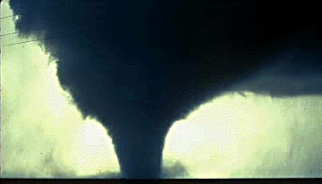
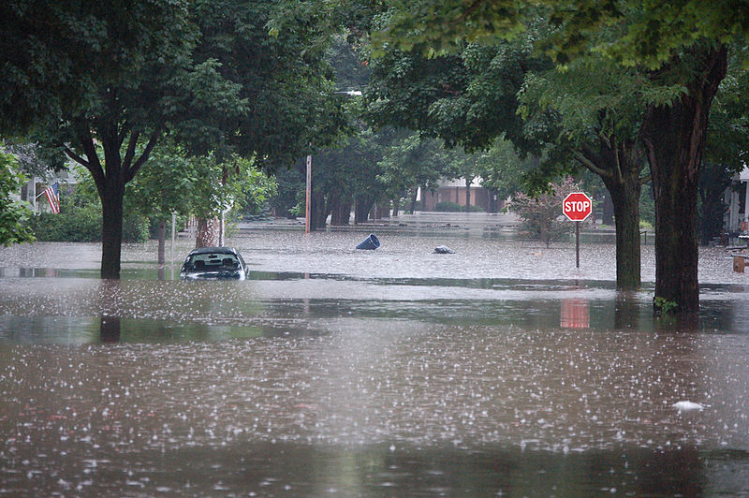
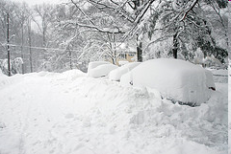
Are You Ready?
FEMA
USGS: Don Becker
Flickr: Jacked01
Notes:
2
Every day, millions of people wake up, go to work, drop their children off at school, and enjoy leisure time with family and friends, following daily routines and schedules. However, when the unexpected does happen, routines change drastically, and people are suddenly aware of how fragile their lives can be. (FEMA IS 7: A Citizen's Guide to Disaster Assistance)
Disasters disrupt hundreds of thousands of lives and cost millions of dollars every year. Each disaster has lasting effects on both people and property. Yet fewer than 40% of American families have any kind of preparedness plan. Individuals and families need accurate information to prepare for possible disasters. Are you ready? (www.ready.gov and www.redcross.org/BeRedCrossReady)

Slide 3
Why Prepare?
Notes:
Group Discussion: What are some possible disasters in your area? What would your family do if you had to evacuate your home? If you had to shelter in place? Why should you prepare?

Slide 4
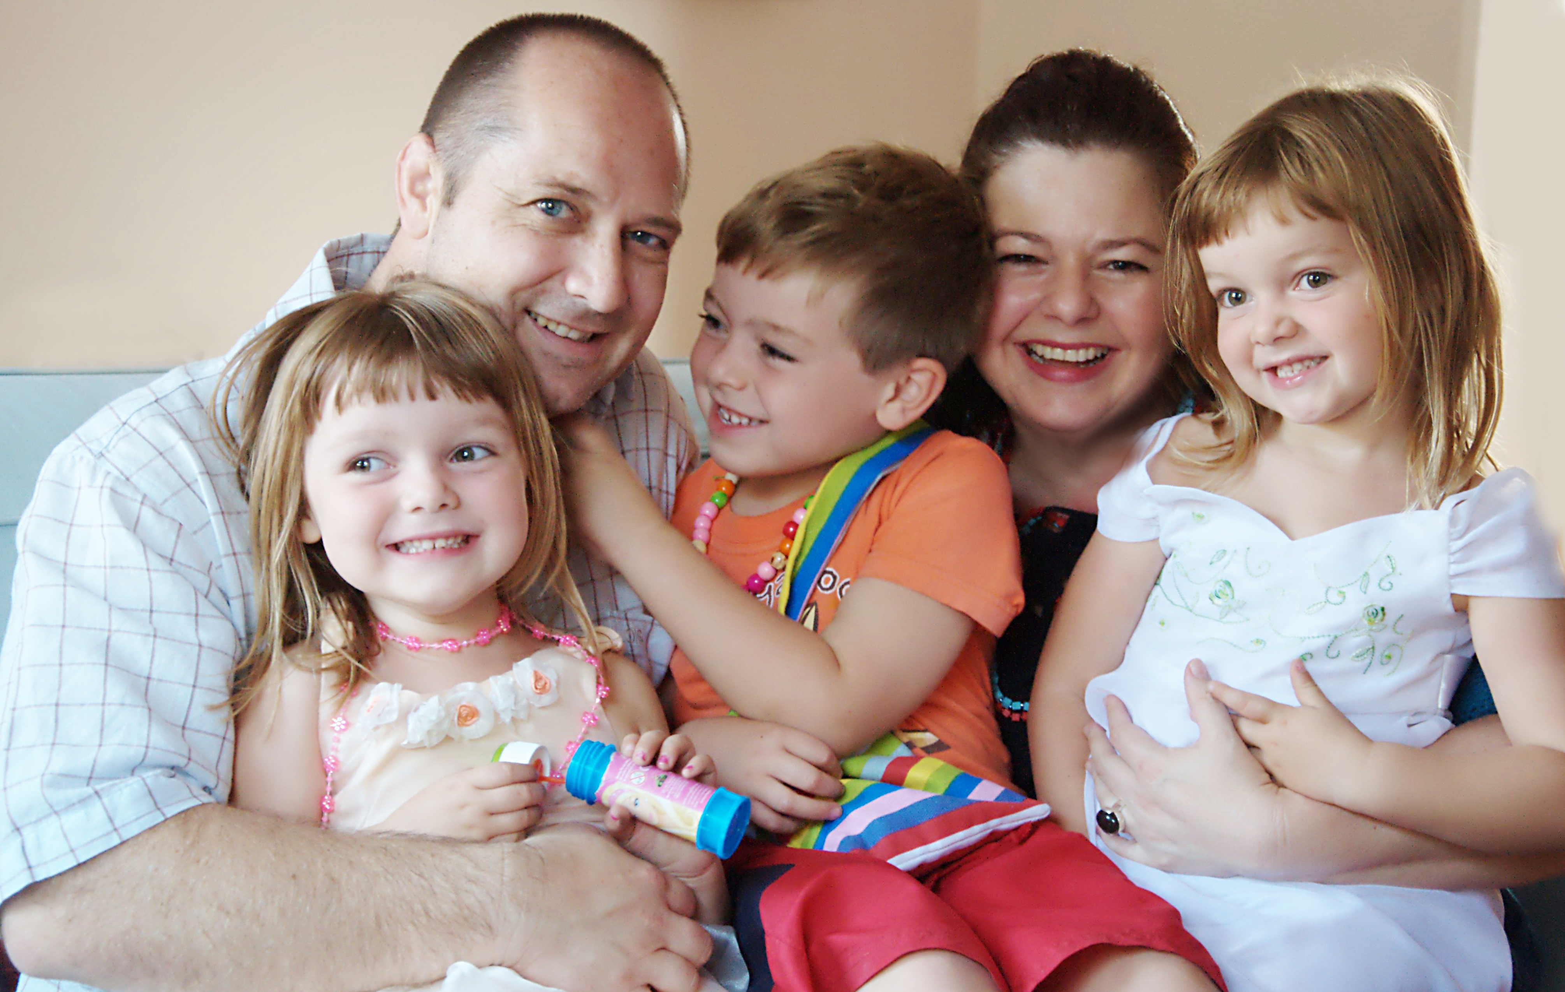
Benefits to Being Prepared
Reduce fear and anxiety
Protect you and your family
Reduce potential damages
Flickr/Yjenith
Notes:
Being prepared and having a plan can reduce fear and anxiety before and during a disaster. What people do before a disaster also can make a dramatic difference in their ability to cope with and recover from a disaster, as well as their ability to protect other household members and family possessions from avoidable losses. (FEMA IS 7: A Citizen's Guide to Disaster Assistance)

Slide 5
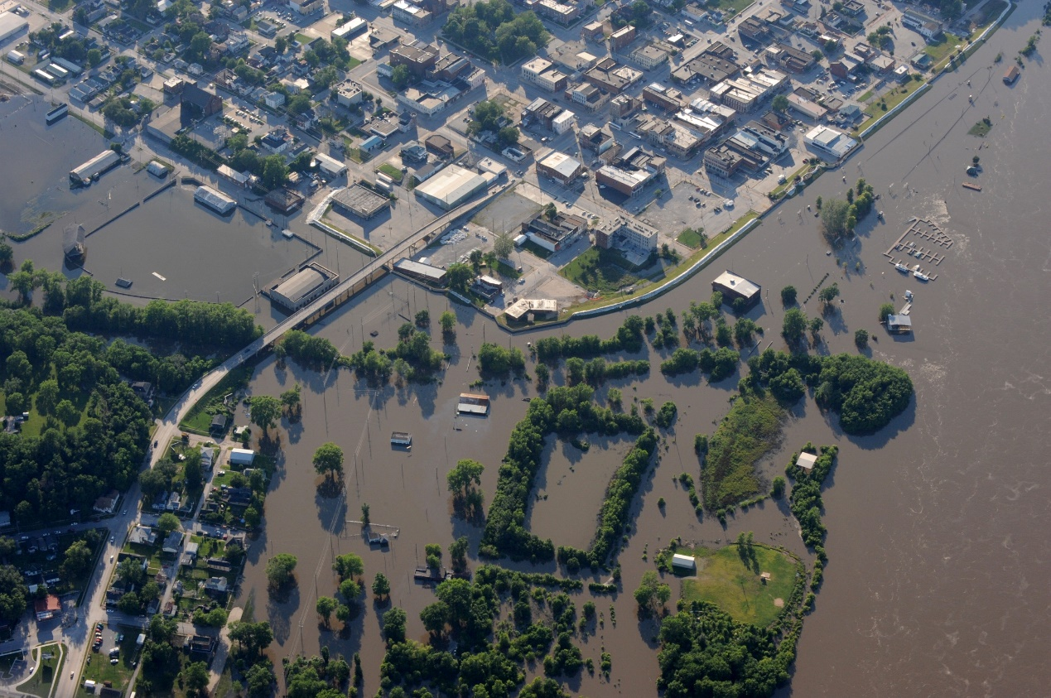
The Need is Real
Minimize impact
Ensure safety & well-being of individuals, families, businesses & communities
FEMA
Notes:
Disasters can range from inconvenient to devastating, but taking some simple preparedness steps in advance can minimize their impact and make a big difference in ensuring the safety and well-being of individuals, families, businesses and communities.
Unfortunately, some communities learn how to prepare for a disaster and reduce its effects only after having experienced one. It is then that they make major improvements in emergency plans, operational procedures, mitigation planning and family preparedness activities to strengthen their defenses. But it is essential to begin planning before a disaster occurs. This program explains how planning and preparing now can reduce the effects of future disasters and the need for assistance. (FEMA IS 7: A Citizen's Guide to Disaster Assistance)

Slide 6
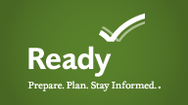
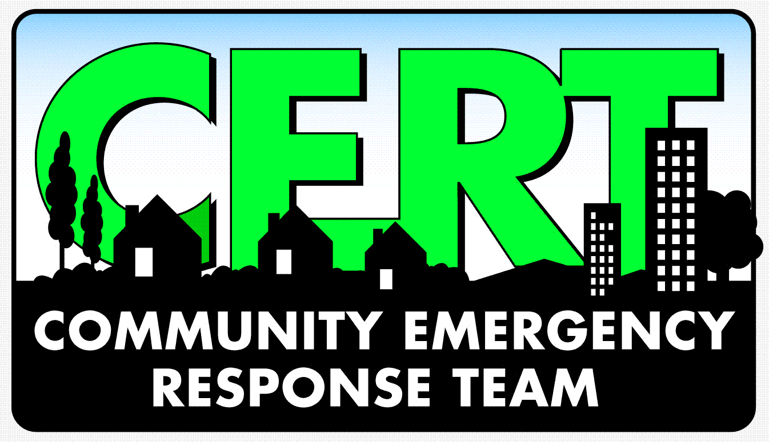
Resources To Help You Plan
Ready.gov
American Red Cross
Community Emergency Response Team (CERT)
Citizens Corps
Faith-based organizations
Extension Service
Insurance companies
Local businesses
And more...
Notes:
Although some extra planning is necessary, you don’t have to do this alone. In addition to the education you are about to receive, other resources also can help you with your family preparedness plan. A few are listed here.

Slide 7
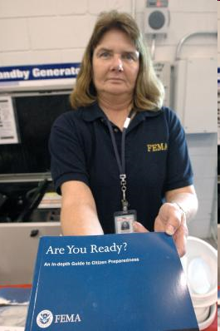
Are You Ready?
Get a kit
Make a plan
Be informed
Get involved
FEMA/ Mark Wolfe
Notes:
To help provide structure in how you can prepare, FEMA, the American Red Cross and other organizations encourage individuals and families to get a kit, make a plan, be informed and get involved. We will discuss each of these steps to preparedness.

