Slide 1
EDEN 101:
A guide to the
Extension Disaster Education Network
Notes:
Welcome to the Extension Disaster Education Network: EDEN! In this EDEN 101 guide, we will learn some basic information, explore how to be a part of the network and share some functions and resources available through EDEN!

Slide 2
What is EDEN?
The Extension Disaster Education Network (EDEN) is a collaborative multi-state effort by Cooperative Extension Services across the country to improve the delivery of services to citizens affected by disasters.
EDEN's mission is to reduce the impact of disasters through research-based education.
Notes:
This mission is carried out through:
• the networking EDEN delegates and other Extension professionals involved
As well as by Providing timely, credible information to those in need
• Connecting with federal, state, and local agencies; and organizations
• Anticipating future disaster education needs
• Serving communities in times of disaster

Slide 3
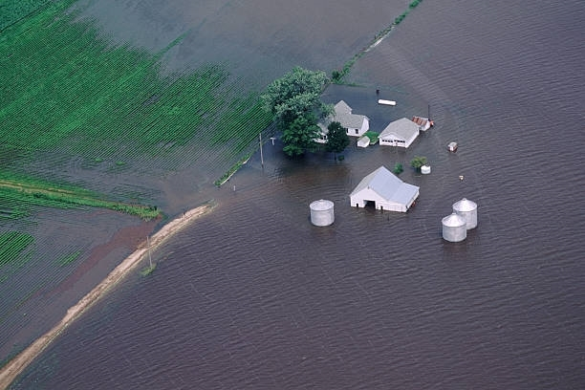
History
EDEN was created after flooding along the Mississippi and Missouri rivers in 1993 inspired the need for Extension’s role in preparation, response, recovery efforts
EDEN is funded by the USDA/ NIFA, Purdue University has managed those funds on behalf of EDEN. The award was competitively granted under a four-year agreement most recently to Purdue in 2018.
Notes:
The conception, development, and growth of the Extension Disaster Education Network (EDEN) were a direct result of the lessons learned by the land-grant system responding to the catastrophic Mississippi and Missouri river floods of 1993. Based on these lessons learned, it was obvious that the Land-Grant system would have an ongoing expectation to be involved locally and nationally in the emergency management arena.
Originally formed as a North Central Region “disaster reduction group” committee. This group received support to develop a proposal for special funds to build on these lessons learned from the Cooperative State Research, Education and Extension Services ( formerly CSREES, nonow the USDA National Institute of Food and Agriculture)
Some questions that were asked to help identify the mission were:
How can we share the resources we already have that apply to disasters?
What resources are available or missing that would be used by the North Central states in the types of disasters that we typically experience?
How can we provide training to Extension staff members in emergency management?
How can we promote scholarly research and efforts that would support this area if Extension were to play a role in it?
Where can we go to find funds that might support these efforts?
Since 2003, NIFA has provided EDEN with funding from the Food and Agriculture Defense Initiative (FADI) to support coordination and communications, web development and maintenance, curriculum development, training, and resources development. Purdue University has managed those funds on behalf of EDEN. The award was competitively granted under a four-year agreement most recently to Purdue in 2018.

Slide 4


Partnerships
EDEN has formal relationships with:
  the U.S. Department of Agriculture (USDA), through its National Institutes of Food and Agriculture (NIFA)
  the National Oceanographic and Atmospheric Administration’s National Sea Grant Program (NOAA Sea Grant).
Notes:
EDEN currently has formal relationships with USDA and NOAA. These formal relationships allow regular collaboration on projects and programs and the opportunity to offer active support.

Slide 5
Membership
EDEN is an alliance of land-grant extension services: 1862, 1890, 1994, Hispanic Serving Institutions, and NOAA Sea Grant Programs.
Institutions, rather than individuals, are EDEN members.
Affiliate membership is open to any individual, organization, institution or agency that are not from an EDEN institutional member.
Notes:
Institutions, rather than individuals are considered as members of EDEN. Becoming a member institution is simple. The director or administrator of an institution or Extension program must sign an EDEN Cooperative Agreement, available on the website, and appoint a Point of Contact for their institution.
EDEN currently has over 90 members institutions and affiliates as of this 2023.

Slide 6
Structure
Each member institution has one Point of Contact (POC).
Institutions may have many additional delegates.
A retiree from a member institution may become a retiree delegate with the approval of the EDEN Executive Committee provided they were a delegate prior to retiring.
Currently more than 400 delegates representing more than 75 different areas of expertise.
Notes:
Each EDEN member (the institution) has one point of contact, but may have additional delegates.
Delegates are included in email communications, which might include throwing out a question or asking for an idea from the other delegates, providing feedback when another delegate poses a problem or question, sharing information and resources, and in general being in the EDEN communications loop. Delegates also are encouraged to take part in the annual conference and join standing committees, such as the Natural Resource Committee, which already has involvement from several SEA Grant members.
Affiliate membership is open to any individual, organization, institution or agency that are not from an EDEN institutional member. Organizations, institutions and agency affiliate members shall identify points of contact (POC) and individuals to be affiliate delegate. An individual person may request to be an affiliate delegate without their organization, institution or agency being an affiliate member.

Slide 7
Point of Contact (POC)
Responsibilities of the POC:
  Serves as primary conduits of information in the network.
  Ensures that state information on the website is accurate.
  Communicating information and issues of interest to colleagues within their institutions.
  Actively encourage new delegates to participate in EDEN committees and projects.
Best Practices for a POC:
  Know your delegates and communicate regularly
  Share resources and materials
  Familiarize yourself with website
  Staying up to date with EDEN functions
Notes:
Any delegate can become the POC for their institution, must be approved by your administrator of director.
The point of contact is responsible for being the program’s main contact with EDEN, and communicating on behalf of the network to fellow Extension professionals at their institution, representing the program in EDEN elections and providing leadership. So, a POC helps to identify and encourage new delegates, spread information and promote and represent EDEN.
Responsibilities:
Best Practices:

Slide 8
Committees
EDEN has eight active standing committees:
  Family and Consumer Sciences
  Professional Development
  Marketing & Membership
  Natural Resources
  4-H and Youth Development
  Agriculture
  Community and Economic Development
  Exercise and Training for Disaster Resilience
Notes:
Standing committees and task forces are essential to EDEN’s achieving its mission. Standing committees and task forces are voluntary and open to EDEN delegates, retirees, and affiliates.
Any EDEN Delegate is able to joining any of the EDEN standing committees, at any time, regardless of area of specialty or background. All committee meet once a month via Zoom to discuss committee projects and programs. Committees are chaired by elected EDEN delegates, who serve one-year terms and oversee meeting agendas and committee projects.
Example of committee projects and programs involve: developing a survey for the network to gather exercise needs and webinar topics, designing handouts and marketing resources, designing Professional Development and train-the-trainer activities and hosting guest speakers to discuss important topics.

Slide 9
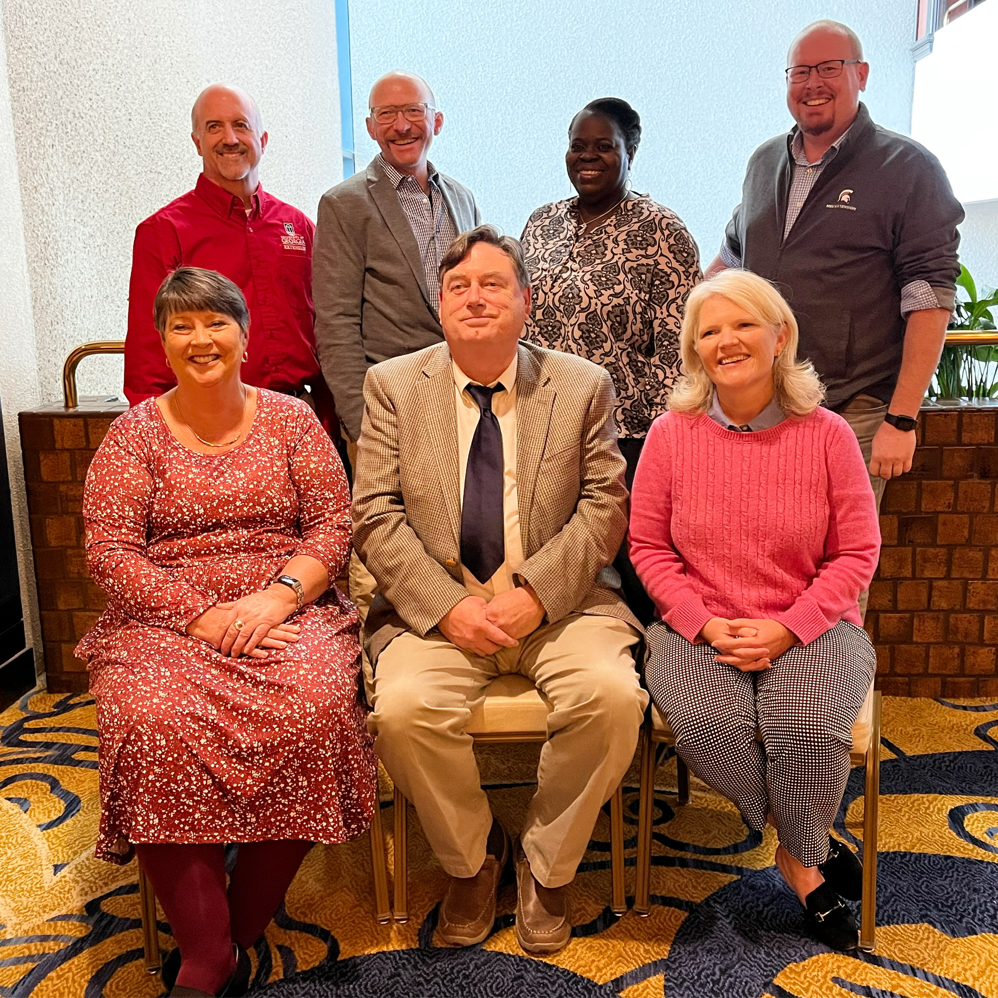
Leadership
EDEN leadership includes the Executive Committee, which is composed of the EDEN Officers, EDEN support staff, EDEN committee Chairs and NIFA, Sea Grant & ECOP Liaisons.
EDEN Officers include the Chair, Chair-Elect and Secretary, all of whom serve a two year term.
Members of the Executive Committee at the 2022 Annual Conference
Notes:
The EDEN executive committee includes the EDEN Committee chairs, who provide regular updates of their committee meetings and projects to the Exec committee and onto the USDA as progress reports.
EDEN officers include the Chair, Chair Elect and Secretary, who all serve a two- year term and are elected by the Points of Contact. The next officer election will take place at the 2024 EDEN Annual Conference.
EDEN Support Staff, who are funded by the USDA/ NIFA Food and Drug Initiative are ex-officio to the EDEN Executive committee.

Slide 10
Resources
Materials for Preparedness, Recovery, Response & Mitigation for Extension Professionals
  Curricula and Publications
  Toolkits and Guides
  Webinars and Videos
  Factsheets and Checklists
Notes:
The EDEN website offers resources for numerous types of disasters, including naturally occurring disasters, man-made disasters, economic disasters and more. The resources are primarily for Extension professionals, but include tools and materials that can be shared with the general public, stakeholders and more. On the website, you can find:
○Curricula and Publications
○Toolkits and Planning Guides
○Webinars and Manuals
○Factsheets and Checklists
○ Exercises
All resources are available under EDEN’s Resource Dashboard, which houses the resources and accompanying landing pages with additional information.
Resources are submitted by delegates to be shared and promoted, or specifically designed by EDEN committees and delegates to fill a gap in the educational materials.

Slide 11
Additional Resources
Professional Development Opportunities
Exercises
Grant Funding Opportunities
Networking and Collaboration
Notes:
EDEN also offers useful Professional Development opportunities, including our webinar series and training opportunities, such as the Religious and Cultural Literacy and Competency in Disasters workshop.
EDEN offers funding opportunities through our EDEN Development Grants, which were just submitted for 2023. These grants have helped support numerous programs across the country, most recently a Large Animal Rescue Training at Texas A&M and the new EDEN COAD Manual,which was developed by the University of Illinois Extension, University of Missouri, Purdue Extension and University of Nebraska Extension.
EDEN’s most valuable resource: the delegates who network! Sharing valuable experiences and advice with others who may need it allows greater preparedness and planning. Having a network to ask your questions, or a specific committee to share your program with allows greater collaboration, improved materials and generally improved work.
Resources are submitted by delegates to be shared and promoted, or specifically designed by EDEN committees and delegates to fill a gap in the educational materials.

Slide 12

EDEN Annual Conference
Hosted yearly in rotating regions
Includes:
  Educational Excursions
  Keynote Speakers
  Poster and Project presentations
  Networking Opportunities
  Professional Development and Training Opportunities
The 2023 EDEN Annual Conference will be September 26th-29th in Savannah, GA.
Notes:
One of the best ways to network within EDEN is to attend the EDEN Annual Conference. Once a year, EDEN delegates assemble to showcase completed projects, share best practices and developing research, and enhance skill-sets through professional development opportunities. The four-day Conference rotates by region, and is hosted in a location that offers delegates the ability to learn about diverse emergency preparedness issues facing the local community.
This gives delegates the chance to learn about disasters that may not be familiar, as well as learn new practices from across the country and gain experience to take home with them. Maybe you don’t experience hurricanes, but you may experience flooding and high winds, so the excursions are always beneficial.

Slide 13

Visit our Website to Learn More!
Learn more about EDEN and see what resources there are for you!
Find your Point of Contact and become an EDEN Delegate
https://extensiondisaster.net/
Notes:
EDEN is a community for support and educational growth for Extension Professionals
If interested in joining EDEN, or if you want to learn more, check out our website at https://extensiondisaster.net/

